Slide 1
Introduction to OOP.
Continuous staff improvement project
Yurii Hohan

Slide 2
Introduction
what is OOP?
Meaning of a type.
Single Responsibility.
Encapsulation.
Understanding inheritance. Understanding association.
Inheritance vs association.
Class Diagram.

Slide 3
OOP
Object-oriented programming is a method of implementation in which programs are organized as cooperative collections of objects, each of which represents an instance of some class, and whose classes are all members of a hierarchy of classes united via inheritance relationships.
(1) Object-oriented programming uses objects, not algorithms, as its fundamental logical building blocks
(2) each object is an instance of some class;
(3) classes may be related to one another via inheritance relationships (the “is a” hierarchy).

Slide 4

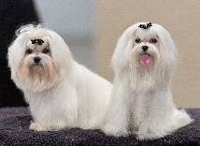

The popularity of OOP Paradigm
A form of abstraction that resonates with techniques people use to solve problems in their everyday life.
Induction (Abstract)
From specialization to generalization
From different dogs to create the word “dog”. Humans use induction
DOG

Slide 5


The popularity of OOP Paradigm
Deduction(infer)
From generalization to specialization
From the word “dog” you have learnt to know an animal is or not a dog.
dog
not a dog

Slide 6
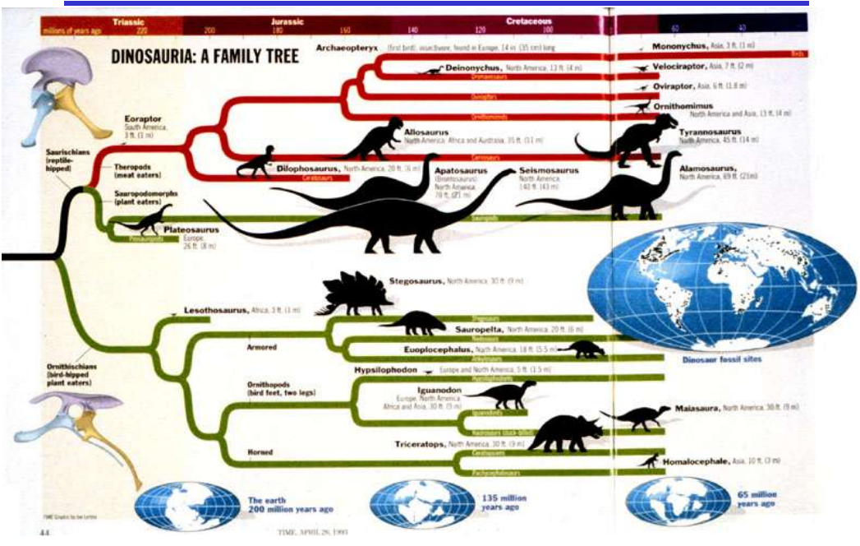
Generalization and Specialization

Slide 7
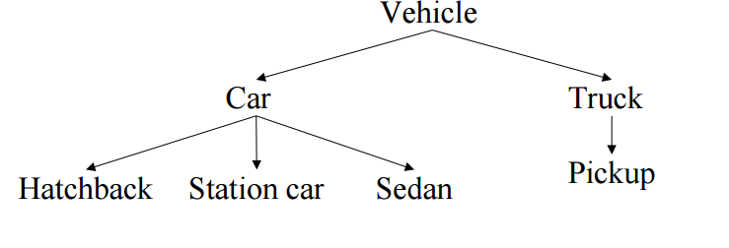
Generalization and Specialization
Generalization creates a concept with a broader scope.
Specialization creates a concept with a narrower scope.
Reusing the interface!

Slide 8
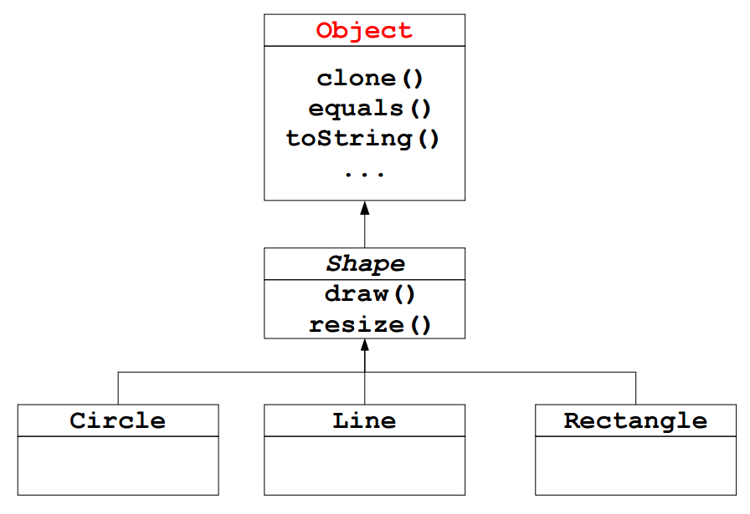
Generalization and Specialization
Inheritance: get the interface from the general class.
Objects related by inheritance are all of the same type.
“is-a” or “is-like-a” relationship

Slide 9
Classification and Exemplification
hat, 23, 34, mouse, telephone, book, 98, 45.34, hello
numbers: 23, 34, 98, 45.34
words: hat, mouse, telephone, book, hello
mouse, tyrannosaurus rex, allosaurus, elephant, velociraptor
dinosaur: tyrannosaurus rex, allosaurus, velociraptor
mammal: mouse, elephant

Slide 10
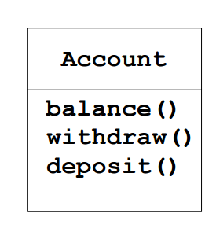
Type and Interface
An object has type and an interface.
To get an object
Account a = new Account()
Account b = new Account()
• To send a message
a.withdraw();
b.deposit();
a.balance();

Slide 11
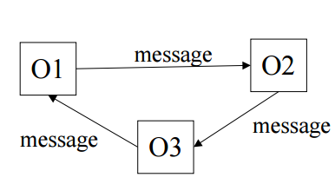
Interaction between Objects
Interaction between objects happens by messages being send.
A message activates a method on the calling object.
An object O1 interacts with another object O2 by calling a method on O2 (must be part of the client interface).
“O1 sends O2 a message”
O1 and O2 must be related to communicate.
The call of a method corresponds to a function (or procedure) call.

Slide 12
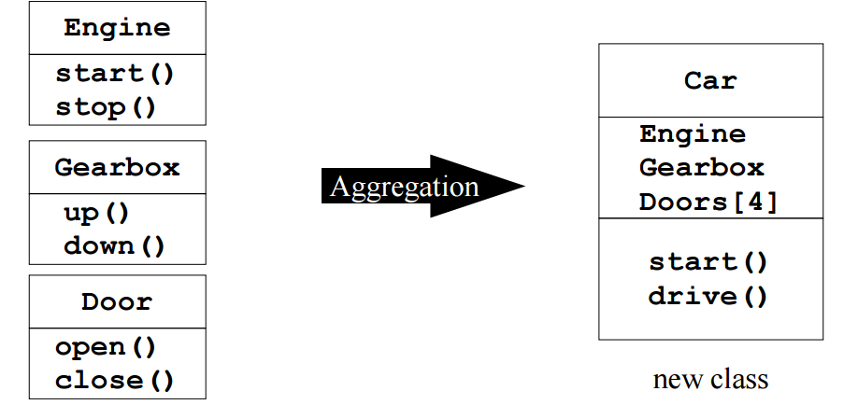
Aggregation and Decomposition
Idea: make new objects by combining existing objects.
Reusing the implementation!
“Has a” keyword. Car “has-a” Gearbox and Car “has-an” Engine

Slide 13
Encapsulation
Encapsulation also can be described as a protective barrier that prevents the code and data being randomly accessed by other code defined outside the class.
To hide the internal implementation details of the class
Keeps class tidy by keeping the visible fields to a minimum
The main mechanism is the access modifiers: private, protected, public, internal

Slide 14
Encapsulation
Combining data and how it's manipulated in one place : This is achieved through the state (the private fields) and the behaviors (the public methods) of an object.
Only allowing the state of an object to be accessed and modified through behaviors: The values contained within an object's state can then be strictly controlled.
Hiding the details of how the object works: The only part of the object that is accessible to the outside world is its behaviors. What happens inside those behaviors and how the state is stored is hidden from view.

Slide 15
Access modifiers
public: visible to all other classes public class Clock
private: visible only to the current class, its methods, and every instance (object) of its class
a child class cannot refer to its parent's private members! private Time time;
protected (this one's new to us): visible to the current class, and all of its child classes protected Hand HourHand;

Slide 16
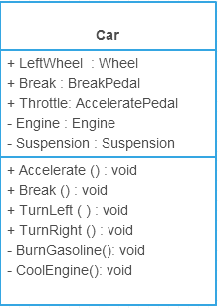
Encapsulation

Slide 17
Inheritance
Allows sharing of the behavior of the parent class into its child classes
one of the major benefits of object-oriented programming (OOP) is this code re-utilization
Child class can add new behavior or override existing behavior from parent
Extremely powerful and extremely dangerous.
“is-a” or “is-like-a” relationship

Slide 18
Inheritance. Terminology
superclass, base class, parent class: terms to describe the parent in the relationship, which shares its functionality
subclass, derived class, child class: terms to describe the child in the relationship, which accepts functionality from its parent
extend, inherit, derive: become a subclass of another class

Slide 19
Is-A
a PersianCat object "is-a" Cat
therefore, it can do anything an Cat can do
it can be substituted wherever a Cat is needed
a variable of type Cat may refer to a PersianCat object

Slide 20
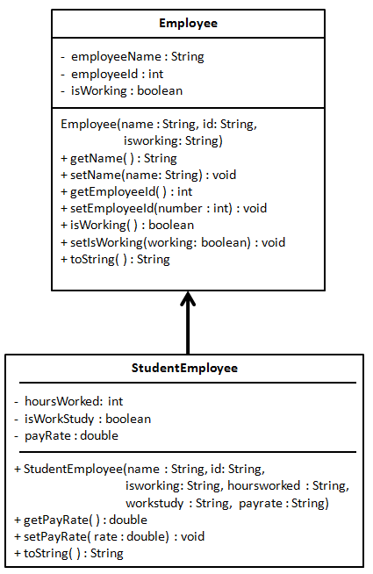
Inheritance. Example

Slide 21
Alternatives to code reutilization
Association is a loose relationship in which objects of one class “know” about objects of another class (has-a)
Aggregation is part-whole relationship (is-part-of)
Composition is similar to aggregation, but is more strict (contains)

Slide 22
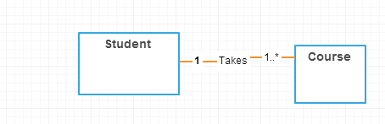
Association
Association is a loose relationship in which objects of one class “know” about objects of the other class.
Association is identified by the phrase “has a”.

Slide 23
Association
Association is a loose relationship in which objects of one class “know” about objects of the other class.
Association is identified by the phrase “has a”.
Association is a static relationship.

Slide 24
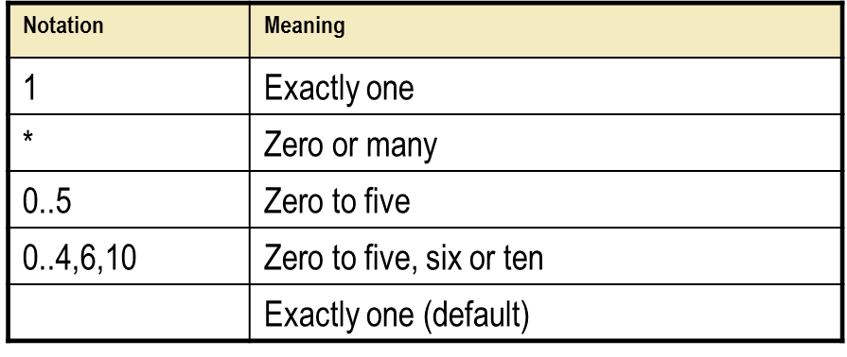
Association. Multiplicity

Slide 25
Aggregation
composition represent a whole-part relationship.
Aggregation is a relationship between part and whole in which:
parts may be independent of the whole;
parts may be shared between two whole instances.
Accessibility: The part objects are only accessible through the whole object.
Lifetime: The part objects are destroyed when the whole object is destroyed.
Partitioning: The whole object is completely partitioned by part objects; it does not contain any state of its own.

Slide 26
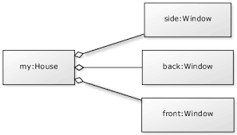
Aggregation

Slide 27
Composition
Composition is a relationship between part and whole in which part is not be independent of the whole.
The contained object is destroyed once the container object is destroyed => No sharing between objects.
Stronger than aggregation.

Slide 28
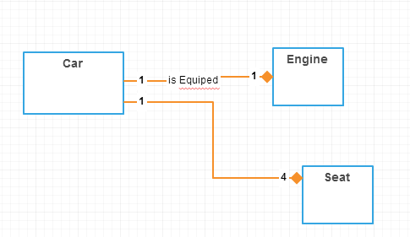
Composition

Slide 29
Inheritance vs association.
Do not forget rule of thumb: “has a” vs “is a”
Start with association and use inheritance only if:
Subclass behaves like parent class
Subclass can be provided instead of base class at no cost
Don't use inheritance just to get code reuse If all you really want is to reuse code and there is no is-a relationship in sight, use composition.
Don't use inheritance just to get at polymorphism If all you really want is polymorphism, but there is no natural is-a relationship, use composition with interfaces.

Slide 30
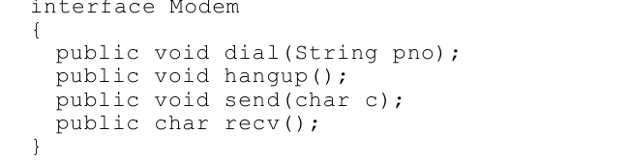
Single Responsibility
THERE SHOULD NEVER BE MORE THAN ONE REASON FOR A CLASS TO CHANGE.
In the context of the Single Responsibility Principle (SRP) we define a responsibility to be “a reason for change.”
Is there more than one responsibility?
The first responsibility is connection management(dial-hangup). The second is data communication(send-receive).

Slide 31
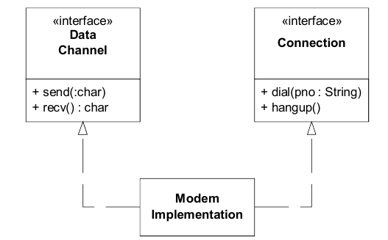
Single Responsibility
Should these two responsibilities be separated? Almost certainly they should. The two concepts have nothing in common.
The SRP is one of the simplest of the principle, and one of the hardest to get right. Conjoining responsibilities is something that we do naturally. Finding and separating those responsibilities from one another is much of what software design is really about.

Slide 32
Single Responsibility. Practice
.NET Framework types:
DateTime. Is it violating SRP?
Windows Forms partial classes. What is it?
String. Is it violating SRP?

Slide 33
Assignment
Choose a preferred domain like cars, banks, Cosmetics, Cosmos, etc.
Create a diagram with an example of Inheritance.
Create a diagram with an example of association.
Create a diagram with an example of Aggregation.
Create a diagram with an example of Composition.
Consider encapsulation.
Consider SRP.
You may use http://creately.com/ or Visual Studio or Enterprise Architect

